Slide 1


Predicting Restaurant Ratings
Prepared by: Timothy Robbins
Bellevue University
Spring 2020

Slide 2
Overview
Business Understanding
Data Understanding
Data Preparation
Exploratory Data Analysis
Modeling
Results
Conclusion

Slide 3
Business understanding
Problem Statement
The creation of an accurate model to predict restaurant ratings
Benefits to Business Owners
Able to determine features that most impact business rating.
Tailor specific features that will promote positive reviews.

Slide 4
Data Understanding
Data Source: Yelp – 9th Dataset Challenge
Link: https://www.kaggle.com/z5025122/yelp-csv#yelp_academic_dataset_business.csv.
Original Dataset: 42,153 rows, 11 metro areas
Revised Dataset: 7,439 rows in Phoenix Metro-area

Slide 5
Data Preparation (continued)
String Manipulation
Feature Names
Eliminated spa ces, replaced periods (‘.’) with underscores (‘_’) and converted to all lowercase
Cleaned up City variable
Originally had 52 cities, containing duplicate and erroneous names
Used functions from stringr package (str_detect, str_trim, str_replace), as well as case_when
Cleaned up obvious errors (misspellings, duplicate names)
Consolidated different string combinations of city name (i.e. Phoenix, Pheonix, Central City, etc.)
Cities with low value counts (< 20) were assigned “Other”

Slide 6
Data Preparation
Missing and Special Values
Converted blank values in all fields to NA
Some business_ids had “#NAME?” as string. Removed from the df
Left NA’s as is since random forests allow for missing values
Data Type Conversions
Converted all attributes to factors
Converted name, open, city stars, and food_type to factors
Dropped unused factor levels using ‘droplevels’ function

Slide 7
Feature Selection and creation
Feature Selection
Dropped the following columns:
Duplicates
Features unrelated to restaurants (i.e. hair type, appointment_needed)
More than 25% missing values:
Temp variables I created that are no longer needed (is_restaurant, state)
Other variables that appear unimportant (i.e. type - all business, business hours, good_for_breakfast)
Reduced variable count from 105 to 35
Feature Creation
Created New Feature: food_types
Used case_when from dplyr package and str_detect from stringr package to extract text from categories field and put in new column called “food_type”
Since case_when pulls the first field it finds, I arranged food_types to extract in specific order with more detailed food types prior to wider categories, for example, Latin American food before Mexican.

Slide 8
Variable | Frequency Count | Proportion |  | Variable | Frequency Count | Proportion
stars | 7,439 | 100.00% |  | attributes_ambience_romantic | 5,685 | 76.42%
business_id | 7,439 | 100.00% |  | attributes_ambience_touristy | 5,685 | 76.42%
categories | 7,439 | 100.00% |  | attributes_ambience_trendy | 5,685 | 76.42%
city | 7,439 | 100.00% |  | attributes_ambience_upscale | 5,639 | 75.80%
full_address | 7,439 | 100.00% |  | attributes_attire | 7,439 | 100.00%
latitude | 7,439 | 100.00% |  | attributes_delivery | 6,712 | 90.23%
longitude | 7,439 | 100.00% |  | attributes_has_tv | 5,884 | 79.10%
name | 7,439 | 100.00% |  | attributes_noise_level | 7,439 | 100.00%
open | 7,439 | 100.00% |  | attributes_outdoor_seating | 6,753 | 90.78%
review_count | 7,439 | 100.00% |  | attributes_parking_garage | 6,615 | 88.92%
food_type | 7,439 | 100.00% |  | attributes_parking_lot | 6,614 | 88.91%
attributes_accepts_credit_cards | 7,439 | 100.00% |  | attributes_parking_street | 6,614 | 88.91%
attributes_alcohol | 7,439 | 100.00% |  | attributes_parking_valet | 6,614 | 88.91%
attributes_ambience_casual | 5,685 | 76.42% |  | attributes_parking_validated | 6,614 | 88.91%
attributes_ambience_classy | 5,685 | 76.42% |  | attributes_price_range | 7,019 | 94.35%
attributes_ambience_divey | 5,691 | 76.50% |  | attributes_take_out | 6,908 | 92.86%
attributes_ambience_hipster | 5,685 | 76.42% |  | attributes_takes_reservations | 6,703 | 90.11%
attributes_ambience_intimate | 5,685 | 76.42% |  | attributes_waiter_service | 6,597 | 88.68%
Revised Dataset

Slide 9
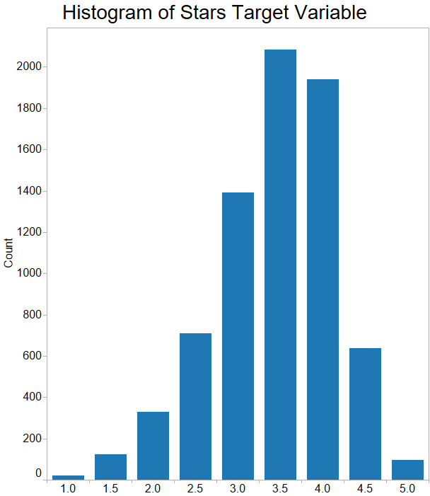
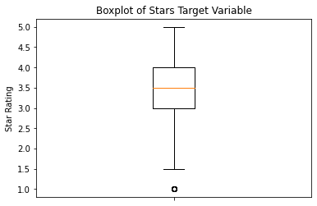
Exploratory Data Analysis
Histogram of Stars Target variable
Skew: -0.5366
Kurtosis: 0.2038
Approximately normally distributed
Boxplot of Stars Variable
Boxplot indicates:
Mean of 3.5 with interquartile range between 3.0 and 4.0.
Potential outliers at 1.0 stars but is valid since that is the minimum rating.

Slide 10
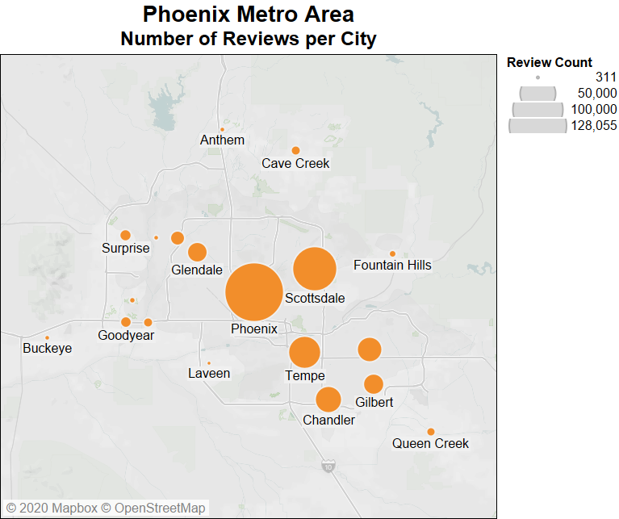
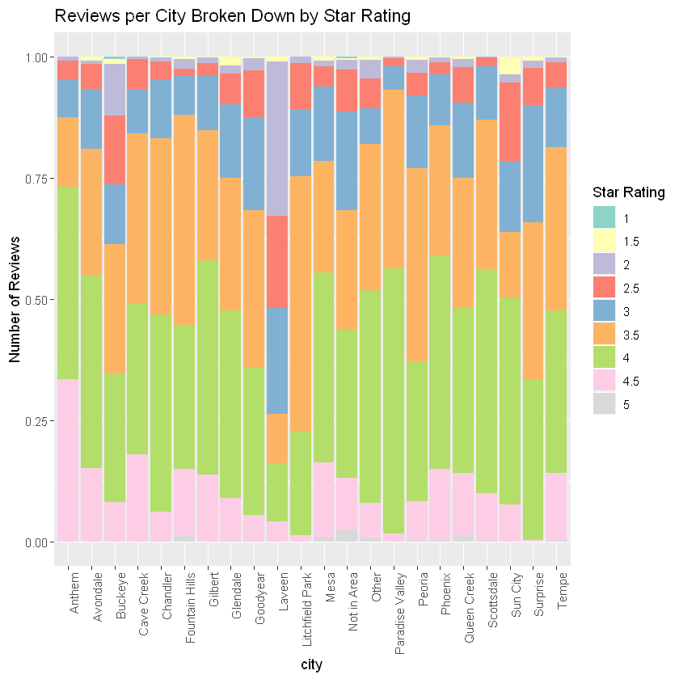
EDA (-cont-) CitY variable
The graph above shows the distribution of reviews in the Phoenix metro-area
Most of the reviews are in the cities of Phoenix and Scottsdale
The stacked bar chart to the left shows the percentage breakdown of stars for each city
5-star reviews are rare. The city of Anthem shows the highest proportion of 4.5-star reviews

Slide 11
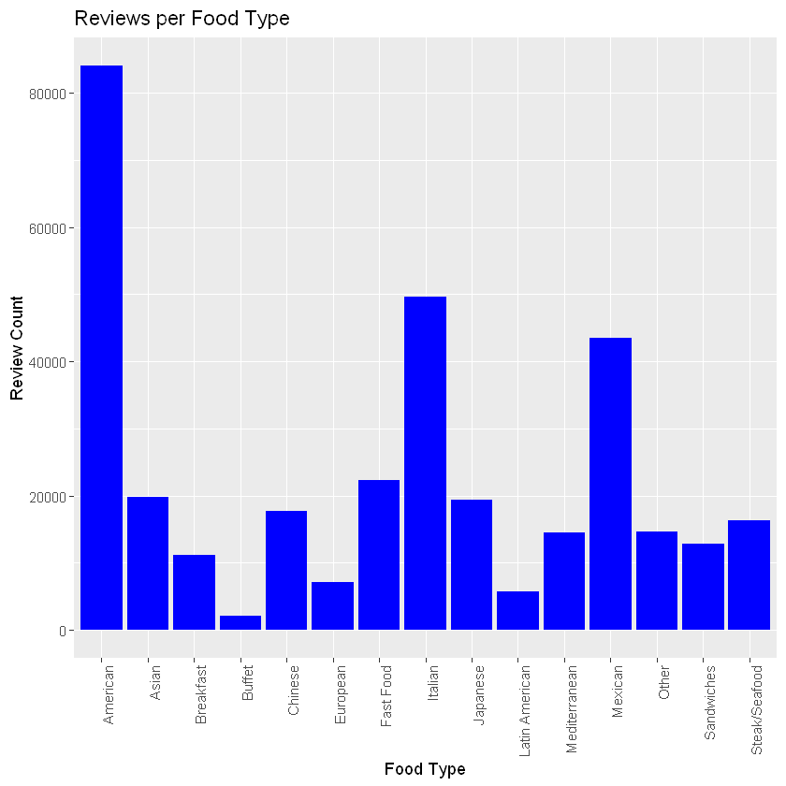
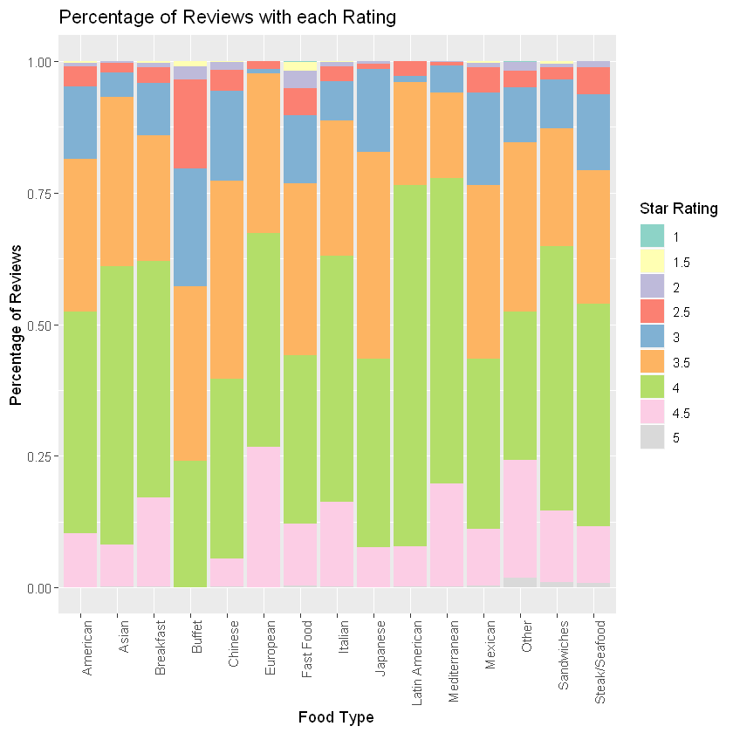
EDA (-cont-) Food Type variable
Bar Chart
The chart in the upper left-hand corner shows that an overwhelming amount of reviews relate to American food, followed by Italian and Mexican.
Stacked Bar Chart
The chart in the lower left-hand corner shows that the number of 4.5 reviews is highest for European and other food types.

Slide 12
Correlation Analysis
Variable | Correlation
attributes_ambience_casual_True | 0.204961
attributes_parking_lot_True | 0.200893
attributes_ambience_touristy_False | 0.188147
attributes_ambience_upscale_False | 0.177596
attributes_ambience_romantic_False | 0.174931
attributes_ambience_intimate_False | 0.174845
attributes_ambience_classy_False | 0.171918
attributes_ambience_hipster_False | 0.170722
attributes_ambience_divey_False | 0.170096
attributes_ambience_trendy_False | 0.162632
attributes_parking_validated_False | 0.155653
Correlations with the stars target variable.
The correlation chart to the right shows that there are 9 ambiance and 2 parking attributes that have positive correlations with the stars target variable.

Slide 13
Modeling
Random Forest Models Used:
Name | Method | Train Accuracy | Test Accuracy
mod_ranger3 | ranger | 0.3706 | 0.3674
mod_randomForest | randomForest | 0.3564 | 0.3554
mod_rf | rf | 0.3525 | 0.3429
Model Preparation:
Renamed levels in stars variable from 1, 1.5, 2, etc. to ‘one’, ‘one_five’, ‘two’, etc.
Randomly split into train and test sets using 60/40 ratio
Automatic creation of dummy variables
Identification and removal of non-zero variance predictors.

Slide 14
RESULTS
Tuned Hyperparameters:
Model: ranger (Random Forest)
mtry: 2
min_node_size: 1
Splitrule: gini
Missing Values: KNN Imputation
Validation: 5-fold cross validation
Final Model:
Train accuracy: 0.3612
Test accuracy: 0.3695

Slide 15
CONFUSION MATRIX
 | Confusion Matrix:
 |  | Actual:
 | Class | one | one.five | two | two.five | three | three.five | four | four.five | five
Prediction: | one | 0 | 0 | 0 | 0 | 0 | 0 | 0 | 0 | 0
 | one.five | 0 | 0 | 0 | 0 | 0 | 0 | 0 | 0 | 0
 | two | 0 | 0 | 1 | 0 | 1 | 0 | 0 | 1 | 0
 | two.five | 0 | 4 | 4 | 8 | 14 | 7 | 9 | 2 | 1
 | three | 0 | 8 | 23 | 29 | 81 | 78 | 48 | 14 | 0
 | three.five | 0 | 4 | 15 | 66 | 183 | 303 | 230 | 45 | 8
 | four | 0 | 2 | 6 | 16 | 67 | 206 | 304 | 114 | 8
 | four.five | 0 | 0 | 0 | 1 | 3 | 1 | 0 | 4 | 0
 | five | 0 | 0 | 0 | 0 | 0 | 0 | 0 | 0 | 0
 | Sensitivity | NA | 0.0000 | 0.0204 | 0.0667 | 0.2321 | 0.5092 | 0.5144 | 0.0222 | 0.0000
 | Specificity | 1.0000 | 1.0000 | 0.9989 | 0.9772 | 0.8726 | 0.5838 | 0.6845 | 0.9971 | 1.0000

Slide 16
Variable importance
Variable Importance (from most to least):
attributes_outdoor_seatingTRUE | 17.75
attributes_has_tvTRUE | 16.85
cityPhoenix | 16.20
attributes_ambience_casualTRUE | 14.33
attributes_price_range2 | 14.29
attributes_noise_levelaverage | 13.74
attributes_parking_lotTRUE | 13.64
attributes_takes_reservationsTRUE | 13.11
attributes_deliveryTRUE | 13.01
attributes_waiter_serviceTRUE | 12.57

Slide 17

conclusion:
Model was fairly accurate in predicting restaurant ratings based on business attributes.
Overall: 36.74% accuracy
Best with the 3.5 and 4.0 star ratings

Slide 18
Risks
Study limited to the Phoenix metropolitan area, which may not be representative of the entire US population.
Text analysis of reviews was not conducted.
Models other than random forest may provide different results.

Slide 19
Acknowledgements
Study conducted independently
Professor Ashley Kern
Recommendation of caret package for R.
Previous study done by Peter Schellenberg

Slide 20
References
Abbott, D. (2014). Applied predictive analytics: Principles and techniques for the professional data analyst. John Wiley & Sons.
Albon, C. (2018). Machine learning with python cookbook: Practical solutions from preprocessing to deep learning. " O'Reilly Media, Inc.".
James, G., Witten, D., Hastie, T., & Tibshirani, R. (2013). An introduction to statistical learning (Vol. 112, pp. 3-7). New York: springer.
Kazil, J., & Jarmul, K. (2016). Data wrangling with python: tips and tools to make your life easier. " O'Reilly Media, Inc.".
Shellenberger, Peter Mark Jr., "Predicting Yelp Food Establishment Ratings Based on Business Attributes" (2017). Honors Theses and Capstones. 374.

